Slide 1
Experience the Innovation
Ku-band Maritime Global TVRO Antenna Systems
Product Overview
i9W
Oct 2010

Slide 2
Table of contents
Different LNB needs
Solution for global satellite TV services
Key features
Antenna unit
WorldView LNB Module
Global coverage
Configuration
Intellian 85cm TVRO products
Price & availability

Slide 3
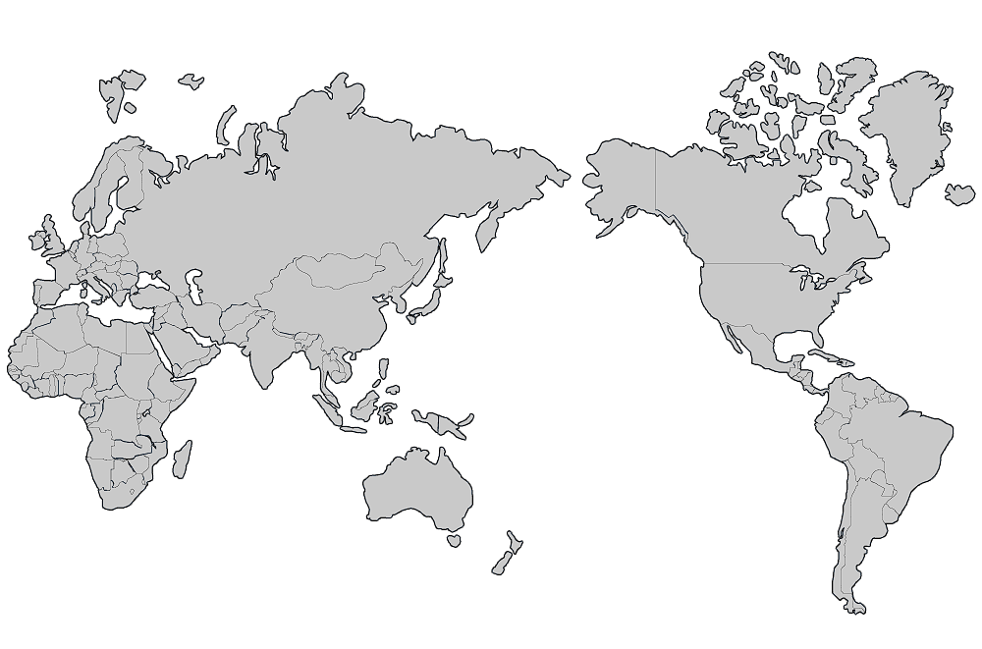
Different LNB needs for different satellite services
Regardless of pay-per-view or free-to-view services, the satellite TV programming signals may be broadcasted on the various frequency bands in either circular polarized or linear polarized form
Therefore, it has always been laborious one as crew needs to climb up to change satellite TV antenna’s LNB manually every time depending on what satellite it is being received from.
9.75/ 10.6 GHz
H/V
11.25 GHz
R/L
11.25 GHz
R/L
10.75 GHz
R/L
10.678 GHz
R/L
10.5 GHz
R/L
11.3 GHz
H/V
10.7 GHz
H/V
9.75/ 10.6 GHz
V/H
Type of LNBs: Different LO (Local Oscillator) frequencies and polarizations (R/L or H/V)

Slide 4
The only solution for global satellite TV receptions at sea
Intellian w-Series is the Intellian’s latest groundbreaking innovation, which integrates a 2nd generation WorldViewTM LNB module for global satellite TV receptions.
Capable of receiving multi-band frequencies and multi-polarizations.
Seamlessly tune in any channels on any satellites to enjoy favorite DTH (Direct to Home) entertainment at sea, just like home.
Intellian’s pre-programmed global satellite library automatically changes the required frequency and polarization without the inconvenience of LNB swap out anymore.
The only solution for Global Satellite TV Service is …
Intellian w-Series (i6W, i9W)

Slide 5
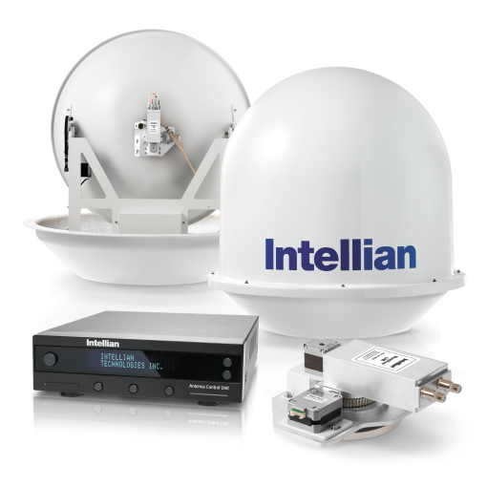
Key features
Intellian i9W
33.5” (85cm) dish diameter
Integrates Intellian’s in-house designed WorldView LNB module
Incorporates multi (8) LO (Local Oscillator) frequencies and multi-polarizations (Linear/ Circular) for global satellite TV receptions
Required LNB LO frequency is automatically switched by the selected target satellite
Offers a rock-solid and the highest stability of ±10 KHz for signal receptions
Provides easy replacement of the LNB without changing any mechanical parts
Capable of receiving next generation DVB-S2 satellite TV services

Slide 6
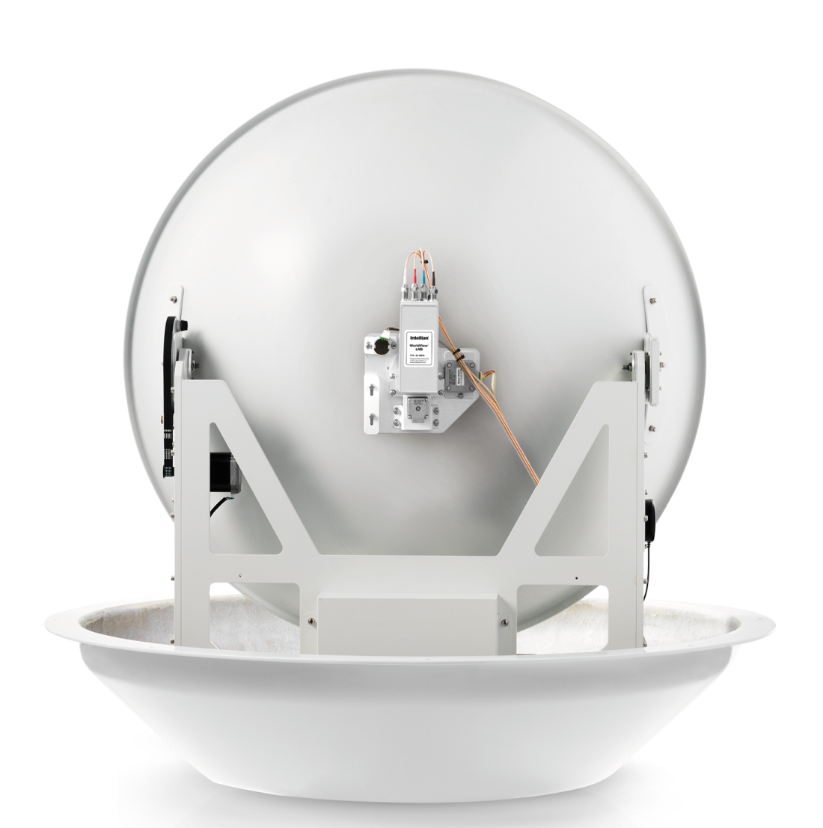
Antenna unit
Main Reflector
WorldView
LNB Module
Sub Reflector
Assembly
Feed Horn

Slide 7
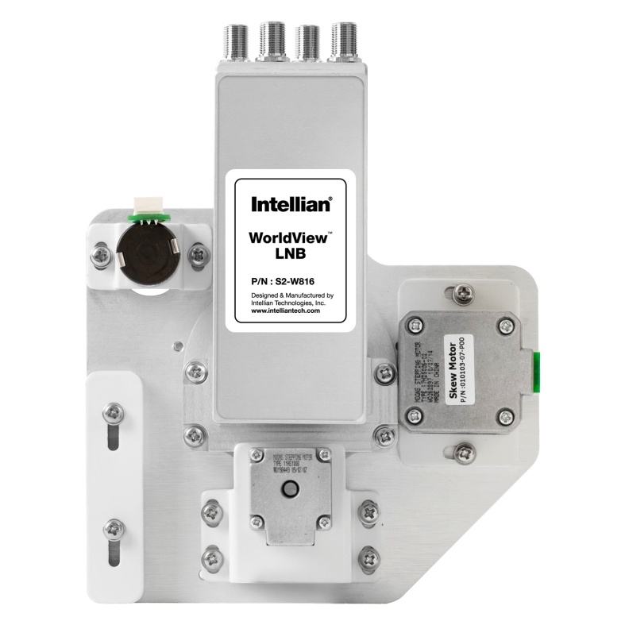
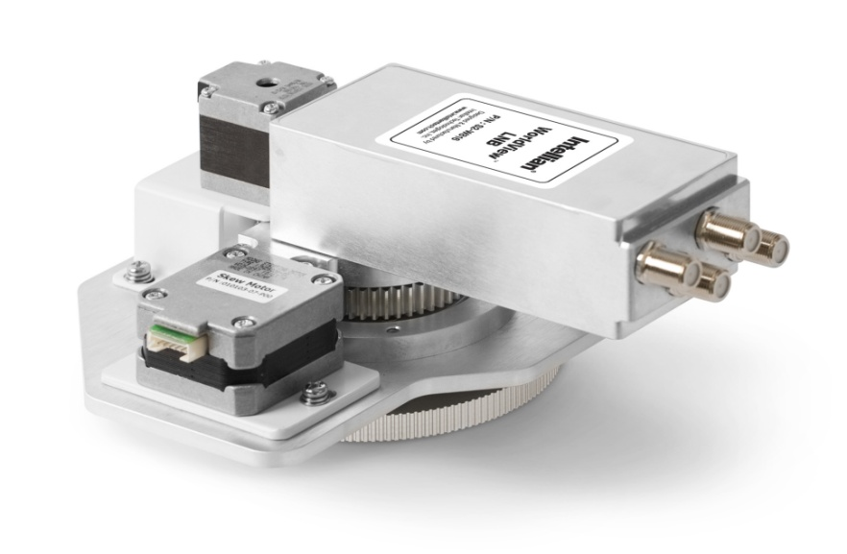
WorldView LNB Module
4 RF ports
Skew Motor

Slide 8
LNB frequencies
WorldView LNB Local Oscillator frequencies
LO Frequency | Bands/ Polarization | Region
11.250 GHz | Dual Circular | North America, Russia
10.500 GHz | Dual Circular | Latin America
10.750 GHz | Single Circular | Korea
 | Dual Circular | China
10.678 GHz | Single Circular | Japan
11.300 GHz | Dual Linear | South East Asia
10.700 GHz | Dual Linear | Australia
Universal: Low 9.75/ High 10.6 GHz | Quad Linear | Europe, Middle East, Africa, some Asian countries
Note)
- LNB LO frequencies are automatically changed according to target satellites
- LNB LO frequencies can be extended
Polarization can be switched between circular and linear
LNB stability: ±10 kHz (Except at Universal 9.75 GHz)

Slide 9
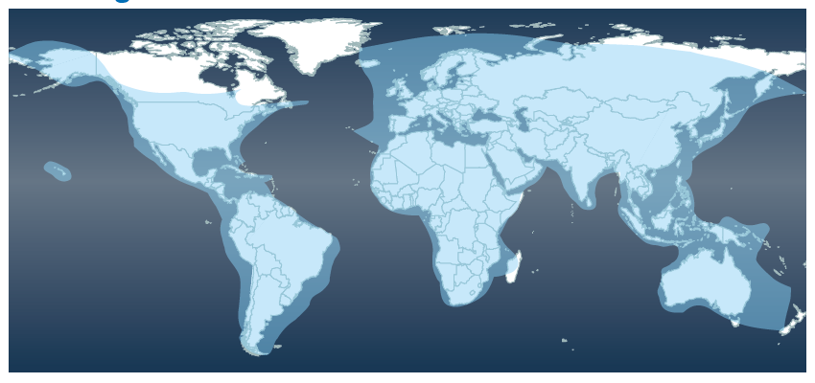
Global coverage
Global coverage of i9W
Multi (8) LO frequencies and multi-polarizations for global satellite TV receptions
Additional LO frequencies can be added

Slide 10
Dual-band configuration
Same configuration as i9P (Universal Quad LNB)
Only RF1 and RF2 coax cables deliver signals while the dual-band is adopted
ACU
Receiver 1
Power
Receiver 2 (FTA)
RF1
RF2 (Optional)

Slide 11
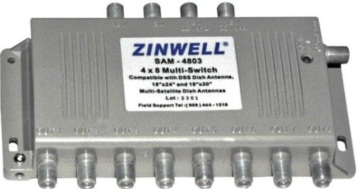
Quad-band configuration
Note) To connect multi-switch, RF1 and RF2 should be connected to Low Band
18V | 13V | 18+22kHz | 13V+22kHz
Horizontal Low | Vertical Low | Horizontal High | Vertical High
ACU
Receiver 1
HL
VL
HH
VH
Power
RF1
RF2
Receiver 8
R7
R6
R5
R4
R3
R2
RF3
4x8 Multi-switch
RF4

Slide 12
Intellian 85cm satellite TV products
 | i-Series | w-Series
Antenna Spec | i9P | i9W
Axis | 2-axis | 2-axis
Dome Dimension (WxH) | 42.5” (108cm) x 43.3” (110cm) | 42.5” (108cm) x 43.3” (110cm)
Antenna Weight | 121 lbs (55kg) | 123 lbs (56kg)
Minimum EIRP | 44 dBW | 44 dBW
Automatic Satellite Switching (TriSat™) | Yes | Yes
Automatic Polarization Control | Yes | Yes
Elevation Range | -15° to +120° | -15° to +120°
Power Input | DC 9 - 30V | DC 9 - 30V
RF Outputs (LNB Polarization) | Quad : Circular or Linear | Quad : Circular and Linear
 | i-Series |  | w-Series
Sat TV Services | i9P |  | i9W
DIRECTV Ku-band, DISH Net HD North America | B2-914S (11.25GHz) | B2-914AA (All- Americas) | B2-914W2 (WorldView LNB) 8 multi-bands LNB Frequencies Linear & Circular Polarization Auto Skew-angle Control Expandable additional frequencies
DIRECTV HD Latin America | B2-910L (10.5GHz)
Sky Mexico, Linear Pol Service | B2-601UQ (Universal Quad)
All-Americas™ LNB Installed | S2-D813 (Optional LNB Only)

Slide 13
Price & availability
List Price
Part Number | Model Name | List Price
B2-914W2 | Intellian i9W | $ 13,495
Availability and Terms & Conditions
Available shipping date: January 2011
Shipping term: FOB Irvine
Warranty: 1 year factory labor and 2 year parts

Slide 14
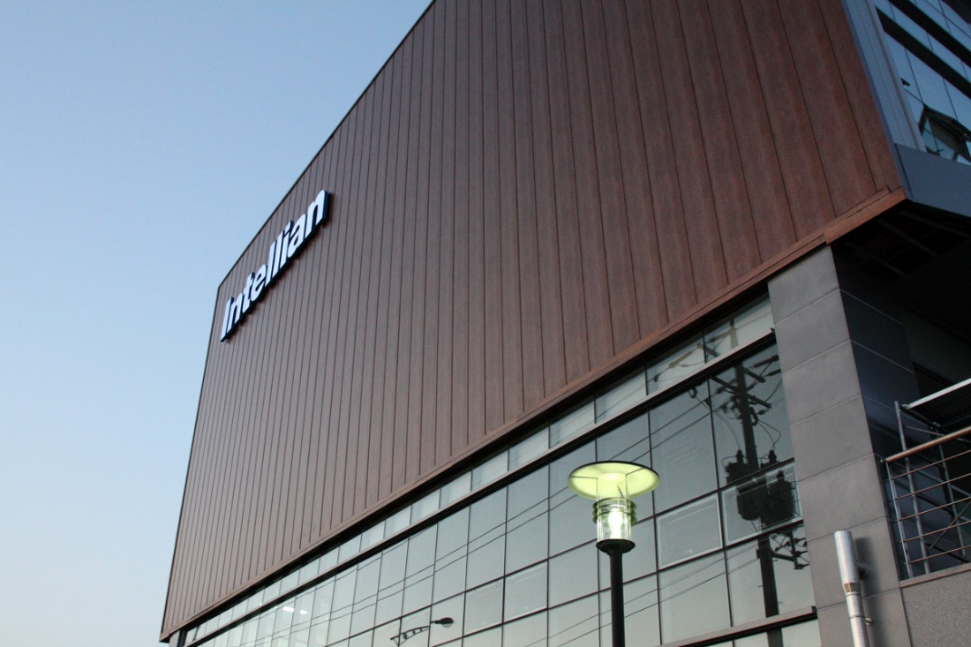
Go with Intellian
Sales Contact;
Sean Hartherley
VP Americas Sales
Office 949 916 4411
Toll Free 888 201 9223
e-mail sean.hartherley@intelliantech.com
© 2006 Intellian Technologies, Inc. All rights reserved.
This presentation is for informational purposes only. Intellian makes no warranties, express or implied, in this summary.

